Slide 1

CONNECTING CUSTOMERS, DRIVING EFFICIENCY
Starting with the First Meter

Slide 2





AGENDA

Slide 3

?

Slide 4
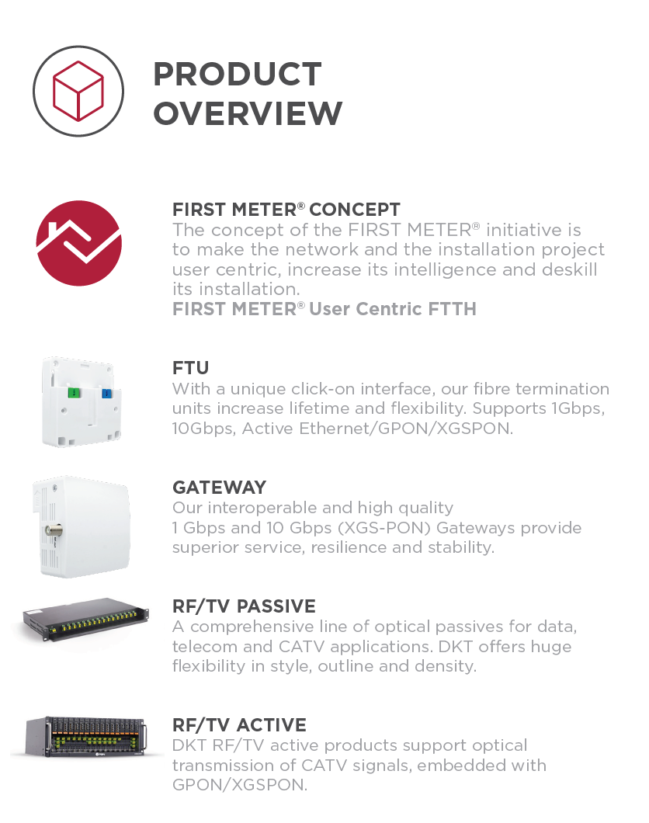

WHO ARE DKT?
Founded in 1977 as “Dansk Kabel TV” to support the growing Danish CATV market
Launched our first FTTH products 21 years ago
Have been supporting major DOCSIS 3.1 upgrades for than 5 years
Today we have feet in both the CATV and fibre worlds

Slide 5

BTV MULTIMEDIA GROUP
In 2019, DKT joined BTV Multimedia Group
  Developing, producing & selling components for cable & fibre-optic networks
  A full-service provider with everything needed to set up, upgrade and operate
8
Organisations
€100m
Revenue
7
Countries
17
Locations

Slide 6









COMPANIES
Distributor and system integrator for CATV and FTTx equipment and measurement and monitoring solutions.
Planning, construction and modernization of multimedia networks as well as installation of high quality smoke detection systems.
Development, production and sales of products and solutions for HFC and FTTx broadband networks.
Production and distribution of active and passive components for the construction of coaxial, FTTH and home networks.
Wholesale of products from the fields of broadband communication, optical fiber, sat, headend and measurement technology.
FTTx system integrator:
Planning, delivery of components, assembly, documentation and network operation.
Full service provider for building, operating and maintaining CATV and multimedia networks.
Preparation, repair and support of broadband communication systems and a network operator's complete range of services.

Slide 7
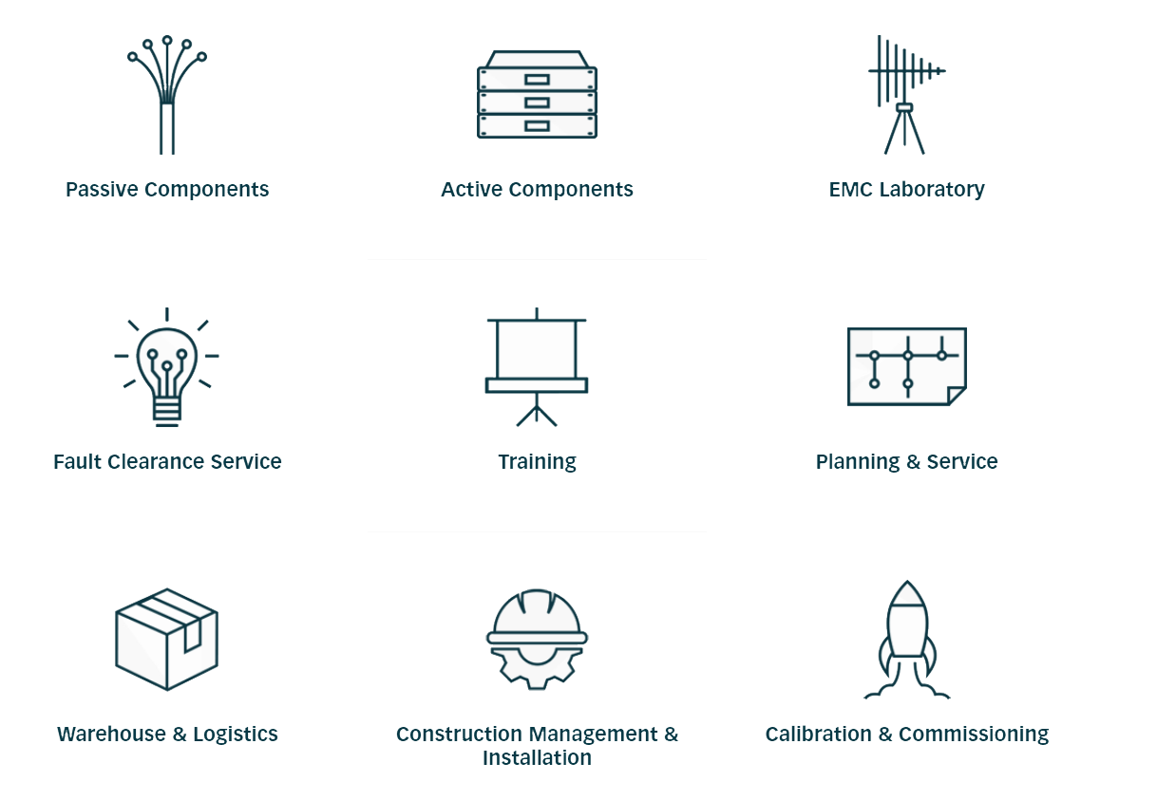
SERVICES
The BTV Group in concert has all the pieces to help deliver both full fibre and HFC networks

Slide 8

CUSTOMERS

Slide 9

360⁰ view of the fibre market

Slide 10
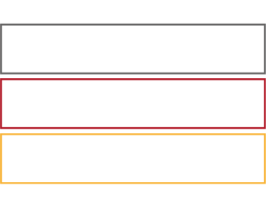

WOW!
Germany adds 2.7 million premises to fibre networks in 2020, an increase of 66% in a year!
UK adds 2 million fibre sockets outside 1.7 million properties, an increase of 65% in a single year!
Source: FTTH Council Europe, Market Panorama 2021

Slide 11

A DROP IN THE OCEAN
When combined, UK, Germany and Italy represent 60% of all the premises across Europe without a fibre connection!
Source: FTTH Council Europe, Market Panorama 2021

Slide 12

WHO’S BUILDING?
With many new operators comes
  More choice
  Greater ability to build on more fronts
  More diverse infrastructure
It also creates increased pressure on scarce resources
  Not least on specialised, experienced labour
Source: FTTH Council Europe, Market Panorama 2021

Slide 13
WHO’S BUILDING IN THE UK
66,293,500
Homes Passed Announced So Far
Based on more than 70 operator announcements linked to investment
62% of this coverage is linked to Altnets
Could result in as much as 635,000km of new network (to the moon & almost back again!)
Source: DKT market analysis

Slide 14
WHO’S BUILDING?
Stage 5
Maturity & Possible exit
Stage 3
Growth & Establishment
Stage 4
Expansion
Stage 2
Start-up
Stage 1
Seed & Bootstrap
Seed & Start-up
Establishment & Expansion
Maturity
Most new fibre is being laid by new Alternative Operators who are having to mature in massive evolutionary steps
  Growth from Stage 1 to 5 may only take 3 years!
  Scaling at pace, delivering quality networks with predictable costs using new and often untested processes & systems

Slide 15
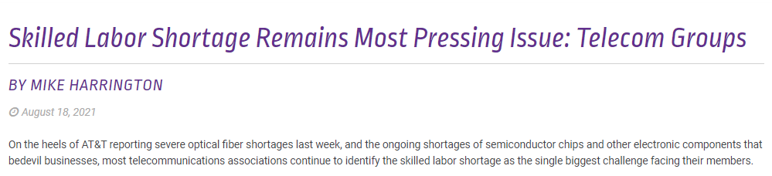

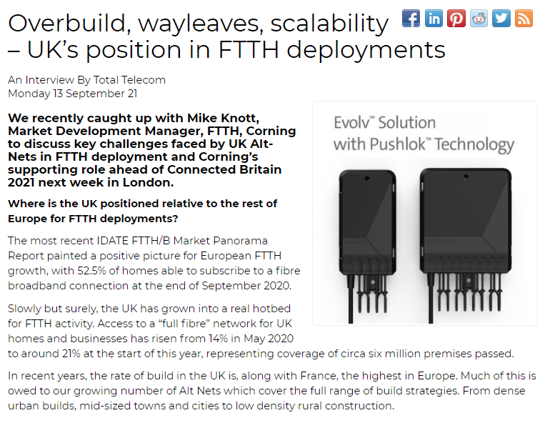
AND WHO WILL BUILD ALL THIS?
Huge and growing demand for construction and installation labour
  Especially for skilled roles such as fibre splicing
European gangs are increasingly being drawn to Germany where networks are being built at the similar rate but avoiding visa and currency issues

Slide 16

FIXING THE RIGHT PROBLEM
Its perhaps unsurprising that some deployments are slower than planned and over budget
  Build quality issues can lead to significant network re-building
  Further impacting the cost and delays
Notes:
https://pxhere.com/en/photo/542966

Slide 17


FIXING THE RIGHT PROBLEM
We need to train
more people!
Its perhaps unsurprising that some deployments are slower than planned and over budget
  Build quality issues can lead to significant network re-building
  Further impacting the cost and delays
Upskilling a workforce is always a good thing but its a long term solution to an immediate problem (and it only addresses one part of the problem)
Notes:
https://pxhere.com/en/photo/542966

Slide 18

STAND OUT!
Scaling a network build from a standing start needs more than good people
If too few people are trained to use the same techniques within the same processes then you will have very little differentiation other than price in an increasingly busy market and still be missing targets
PEOPLE
PROCESS
PRICE

Slide 19


STAND OUT!
Scaling a network build from a standing start needs more than good people
If too few people are trained to use the same techniques within the same processes then you will have very little differentiation other than price in an increasingly busy market and still be missing targets
As Albert Einstein said
  “the definition of insanity is doing something over and over again and expecting a different result.”*
* Although he almost certainly didn’t
http://www.news.hypercrit.net/2012/11/13/einstein-on-insanity/

Slide 20

TIME TO GET CLOSER
TO YOUR VENDORS
Good vendors are more than just suppliers
  They know their products inside out and backwards
  They know how to integrate them into sophisticated solutions
  They aren’t afraid of interoperability and know how to avoid vendor lock-in
  They are innovators in their own right, able to create the elements that make the whole greater than the sum of the parts
Ask for more
Expect them to help
  Drive efficiency
  Drive innovation
  Drive integration

Slide 21


WIDEN
THE TALENT POOL
  Simplify the technology & processes
  Innovate & differentiate from the crowd
If the talent pool is too shallow, widen it.
Notes:
https://pxhere.com/en/photo/185488

Slide 22



Slide 23

FIRST METER PHILOSOPHY
Centred on the customer’s experience from the first meter within their home
Simplicity in service activation & operation
Prepared for the future and open to all
Resilient & reliable
Minimally disruptive for the lifetime of the service

Slide 24

FIRST METER
IN PRACTICE
Gives your customers more control
Reduces the skills needed for a customer installation to those in a local handyman’s toolbox
Embeds smart testing for reliability & customer assurance

Slide 25
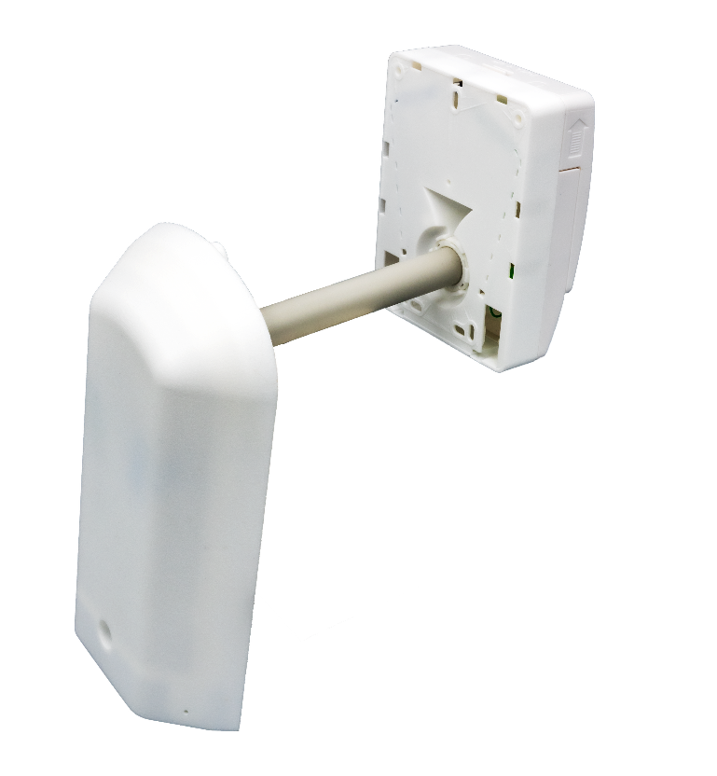
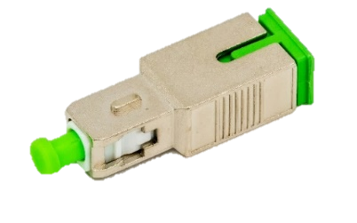
FIRST METER
EXTALLATION
Combined external wall box & universal internal fibre termination
If an installer can drill a hole, they can install an Extallation unit
  It’s even designed to support flexible drilling angles
Supports an optical reflector
  Internally for maximum accuracy
  Externally by an engineer for external ad hoc tests

Slide 26


FIRST METER
CLICK & CONNECT
Universal click-on gateways
  GPON
  1Gbps Ethernet
  XGSPON & 10G EPON
  10G Ethernet
With and without RF support

Slide 27
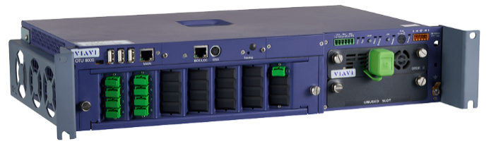

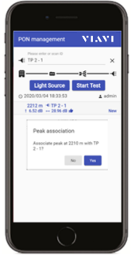


CENTRALISED PON TESTING
Increase speed
  Deployment, activation & repair
Better quality network build
  Avoiding remedial work
Widen the talent pool
  Simplifies installation without compromising build quality
  Only a smartphone is needed in the field
And in operation, ensure SLAs achieved
  Reduces dispatch of wrong team
  Visibility to network health and team performance
Splitter
Homes Passed
DP
Reflectors
Premise Connect
ONT

Slide 28


PRE-TERMINATED DROP CABLES?
Pre-terminated drop cables have significant cost & operational benefits
  Further reducing installation time while using a wider skills base
They also make it impossible for an OTDR to differentiate between different legs of a PON
Our compact, self-contained fibre splitter unit ensures each leg of a PON is clearly differentiated
  Standard LGX form factor
  A simple replacement for existing final-stage splitters with 8:1 and 16:1 variants with SC/APC connectors

Slide 29
WHAT VENDOR
QUALITIES DOES THE MARKET NEED NOW?
Customer-led innovators
Comfortable with multi-vendor solutions
Belief in open access, rejecting vendor lock-in
Customer intimacy by working collaboratively, adapting to meet local requirements
And ideally one that has long experience of doing all of this

Slide 30
THANK YOU
https://dktcomega.com/first-meter/

