Slide 1
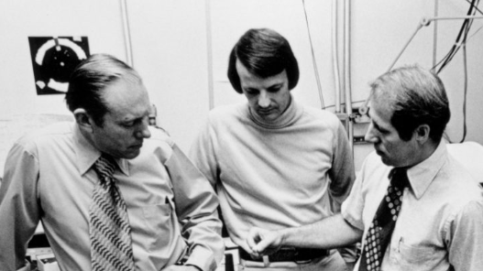

Slide 2
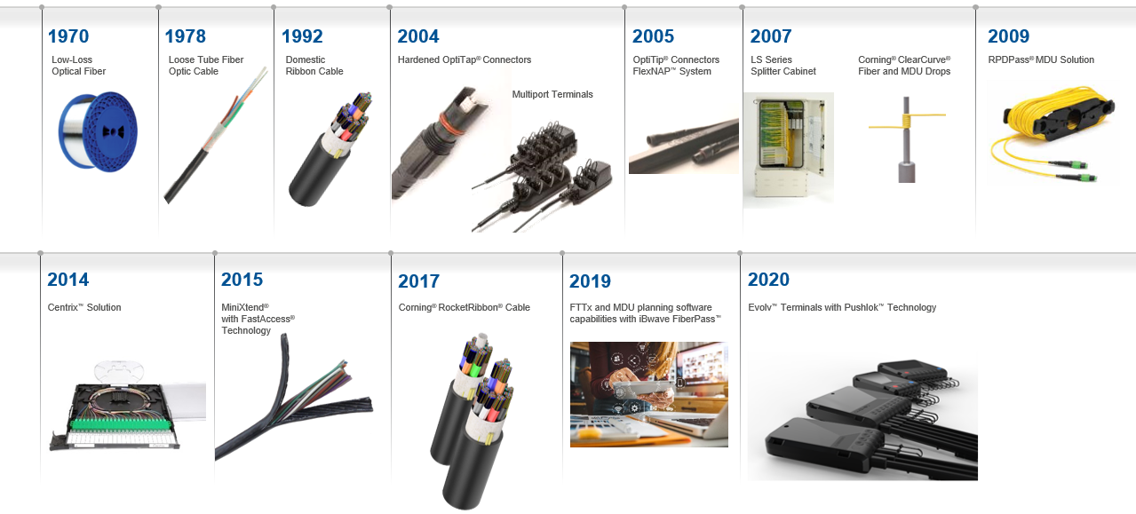
Track Record Of Innovation
Corning Optical Communications
Carrier Network Innovation History

